Slide 1
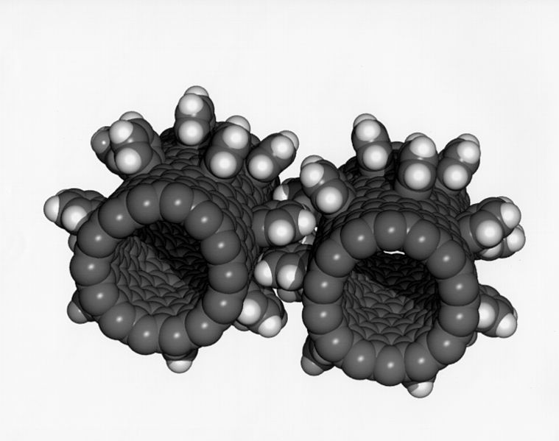
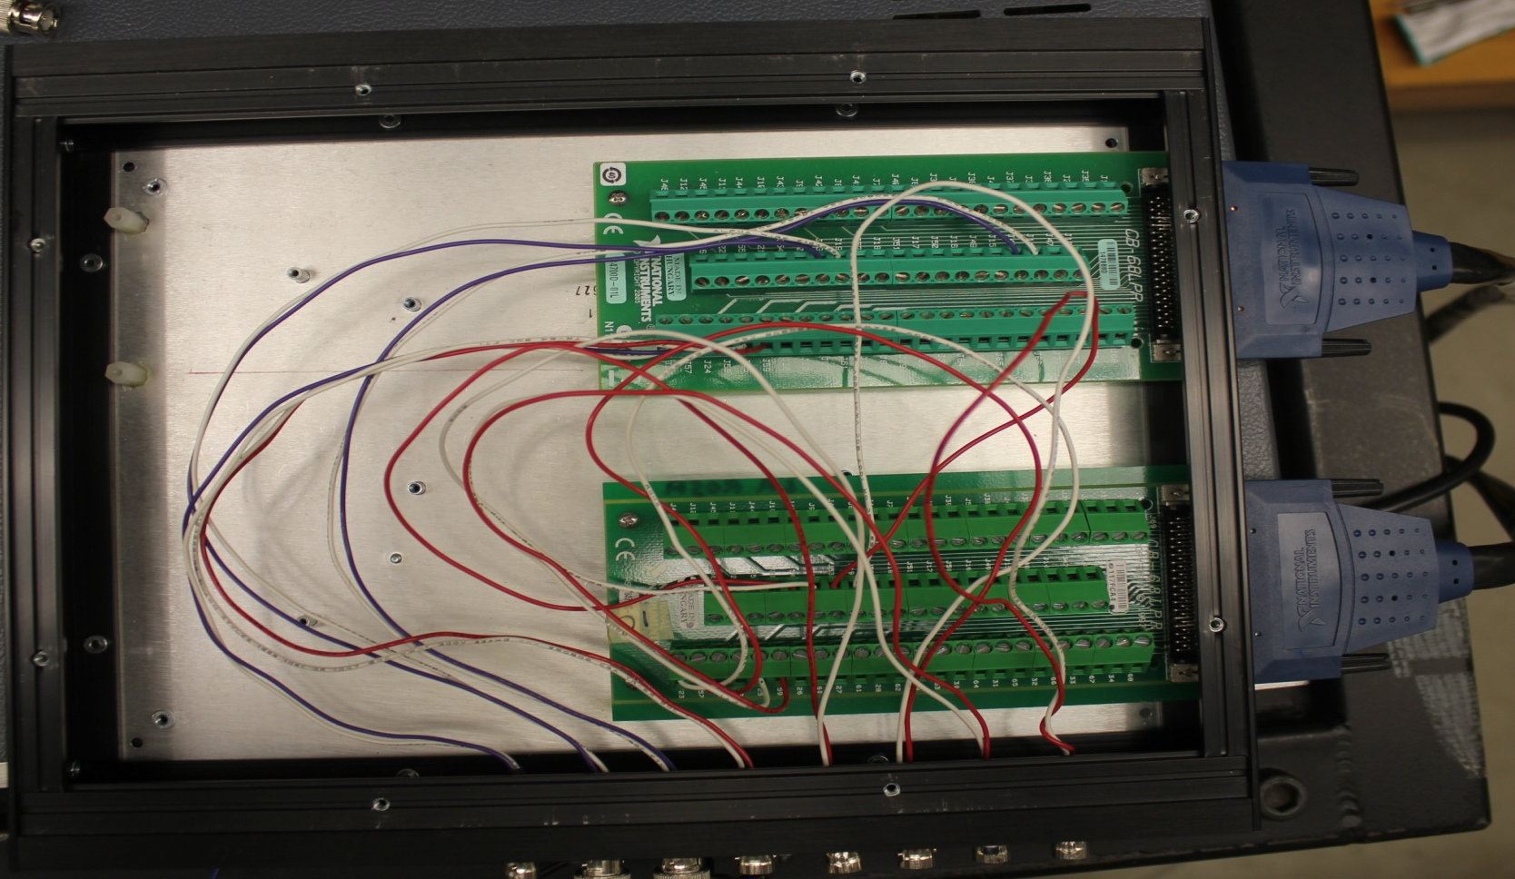
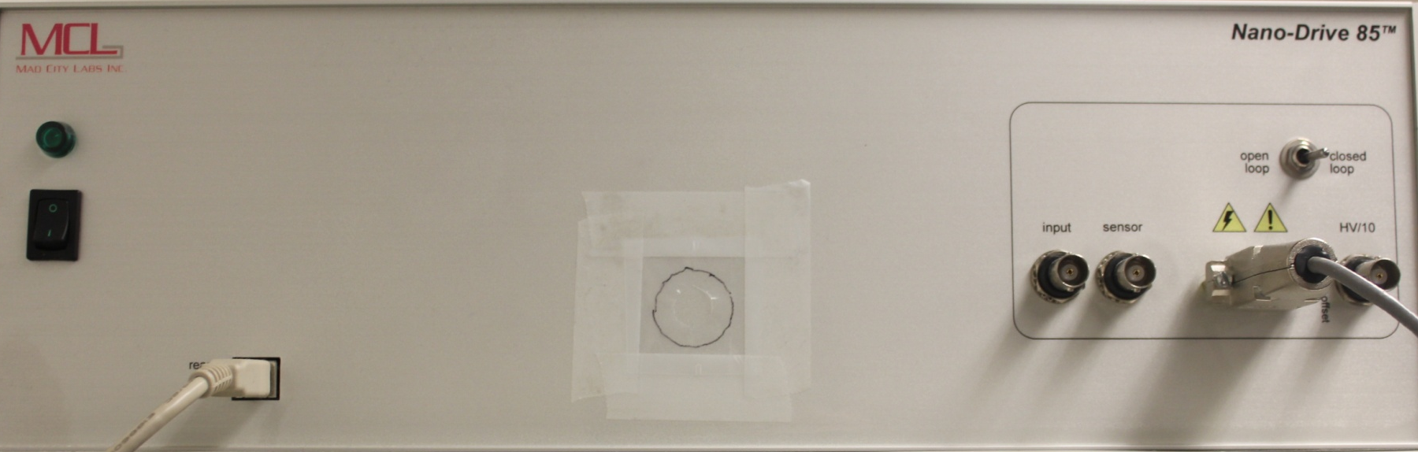
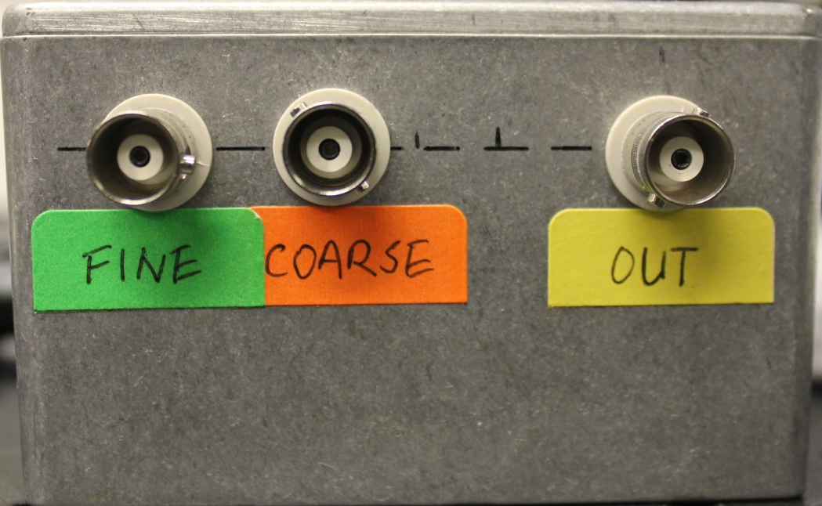
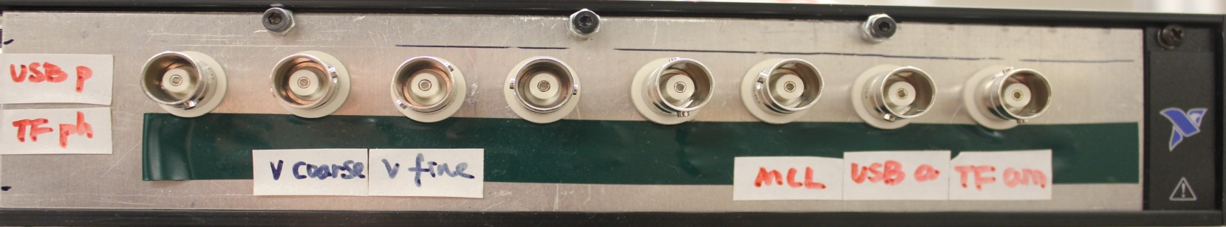
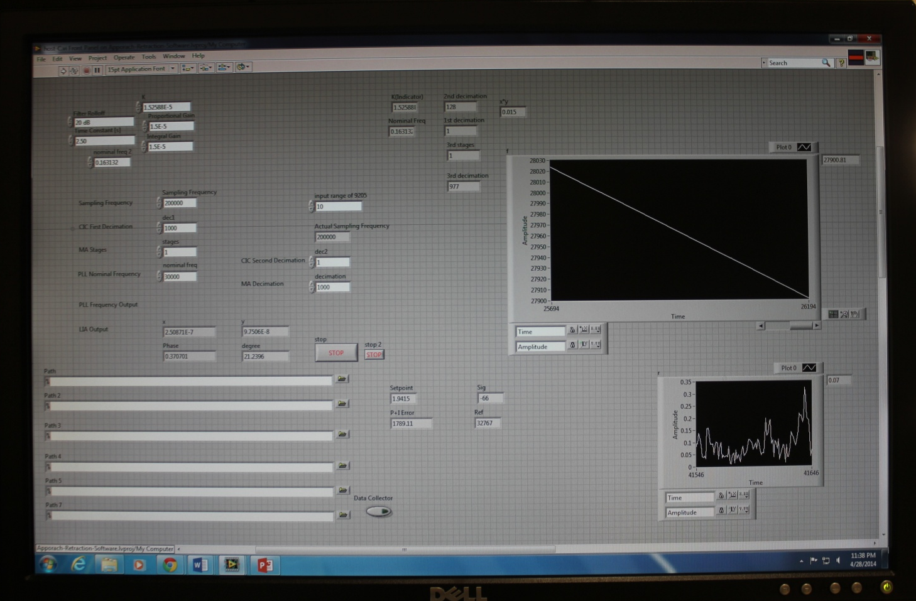
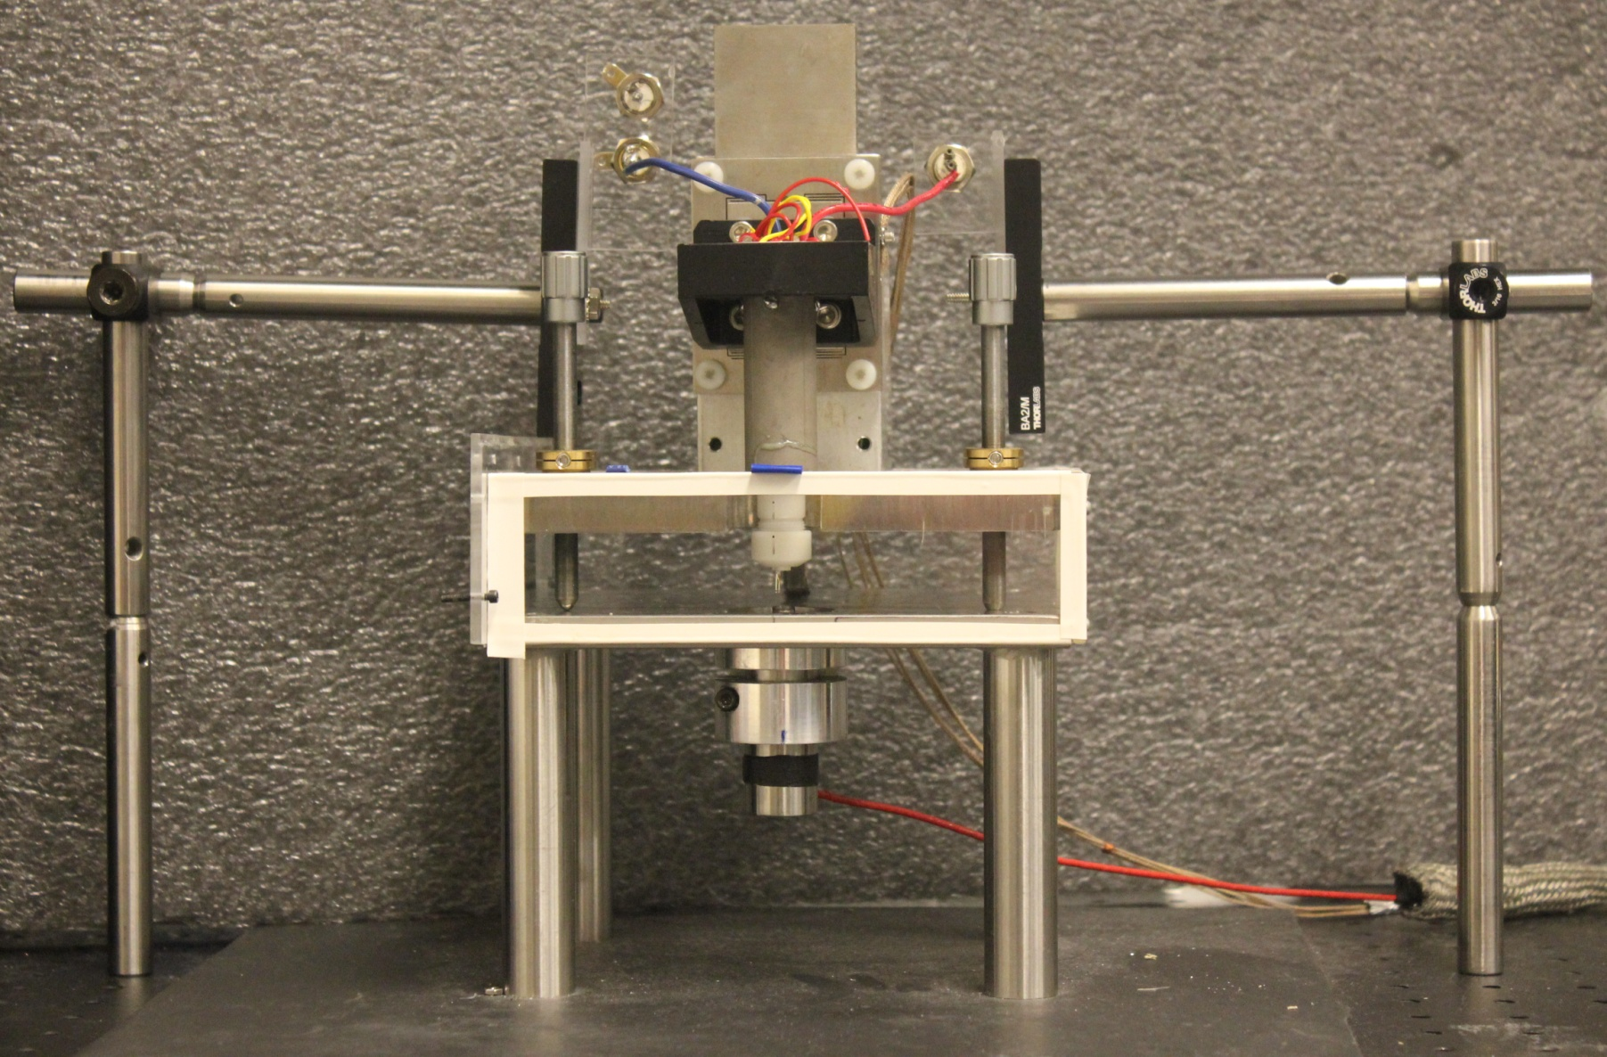
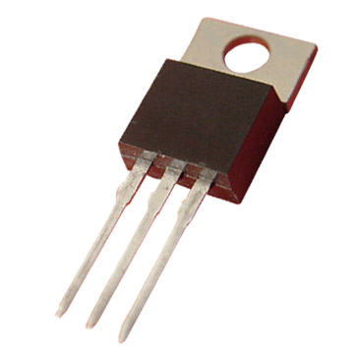
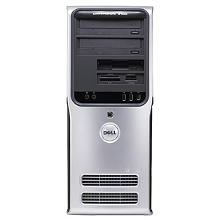
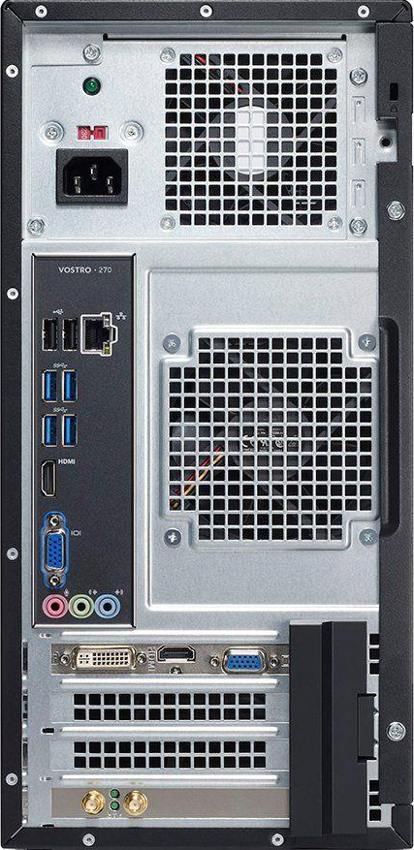
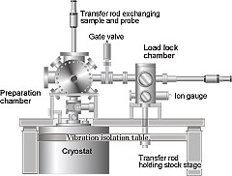
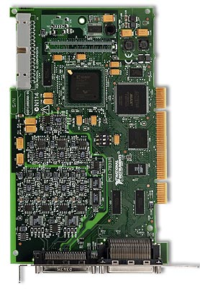
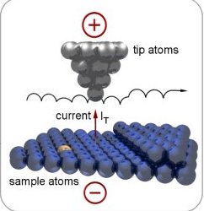
PROBLEM
RESULTS
Currently, the interactions between hydrophobic molecules are not properly understood. The newly improved SANM instrumentation can observe the properties and effects of two hydrophobic molecules interacting with each other. The high resolution and sensitivity of the newly improved SANM instrumentation can pave the way for critical research in finding a cure for these neurodegenerative disorders.
TF Behavior in Air
TF Behavior in Vacuum
The six graphs in this section display the functionality of the Digital Lock-In Amplifier, PID Microcontroller, and the Voltage Controlled Oscillator.
Tuning Fork
Piezo Holder
SR-850 Lock-In Amplifier
This set of graphs represent the phase and amplitude graphs taken by the SR-850 and the Digital Lock-In. The data shown was taken in a frequency sweep ranging from 32.758 kHz-32.769 kHz. The resonance frequency detected by the SR-850 was 32764.3 Hertz and had a max amplitude of 129 nanoamps. At this frequency, the phase shift was calculated to be 88 degrees. The Digital Lock-In graphs display the resonance frequency around 32764.3 Hz with a max amplitude of 129 nanoamps and a detected phase of 89 degrees. The results from the SR-850 closely match those from the Digital Lock-In.
Digital Lock-In Amplifier
Piezo Holder
Tip oscillating
in air
Tuning Fork
Cell Membranes
Versus
Tip oscillating
in vacuum
The graph above represents the PID Error Output and the graph below represents the VCO Output. In the PID graph, the resonance frequency equates to a plateau in the graph where the slope is zero. The PID has detected a 90 degree phase shift and does not add error. In the VCO graph, the resonance frequency also equates to a plateau in the graph where the derivative is zero. The VCO realizes that the PID has noticed a 90 degree phase change so it stabilizes its frequency.
Cell membranes have many mechanical properties that are not completely understood by biologists. Cell membranes are the main barrier in letting objects pass through in and out. Their importance is essential in a functional cell. The sharp probe of the newly improved SANM instrumentation can perturb the cell membrane to determine rigid and elastic properties.
Cell Membrane
Mesoscopic Liquid
The empty space surrounding the TF is vacuum
Glass Slide
Solid Substrate
Ultrasonic Sensor
Resonance in Air
Resonance Frequency in
Vacuum
Resonance in Vacuum
NEMS/Nanofluidic Devices
Nanoelectromechanical systems, NEMS, are on the verge of transforming technology. One of the main obstacles in using NEMS is the high frictional force when these tiny machines work. This has been an obstacle in further development. By studying the mesoscopic fluid, nano-lubricants can be manufactured to counteract friction on the nanoscale.
CONCLUSION + INTEGRATION OF SANM AND FREQUENCY MODULATION
With frequency modulation proven to work by analysis of all four stages, the SANM with frequency modulation combination is a much better instrumentation equipped to characterize the properties of the mesoscopic fluid. Each stage has reliable functionality and completes its job to make the loop continuously running. By having frequency modulation instantaneously operate the tuning fork at the maximum amplitude, the changes in amplitude monitored by the tuning fork can be solely characterized from the mesoscopic fluid. The simulation depicted is the workstation where I operate.
Breakout Box
The graphs and diagrams above depict the QTF vibrating in two different mediums: air and vacuum. The graphs depict the amplitude of the tuning fork based on the corresponding frequencies. The resonance frequency is the frequency that corresponds to the highest amplitude peak in the graph. In air, the resonant frequency is at 32,756 Hz at an amplitude of 60 nanoamps. In vacuum, the resonant frequency is at 32,764 Hz at an amplitude of 350 nanoamps. Also in SANM, the tip starts in air and penetrates the liquid. With this type of setup, the tip vibrates in two different mediums (air and liquid). In keeping this concept constant, imagine the QTF vibrating in vacuum at its resonant frequency and introducing the QTF to air. It can be seen that the peak amplitudes in air and in vacuum differ and this is due to the increased resistance of air. But, there is an additional decrease in amplitude due to the fact that the resonant frequency in vacuum is not the same as in air. This additional decrease in amplitude is due to the mechanical nature of the QTF phenomenon. Multiple factors cannot influence the decrease in amplitude because the amplitude decrease cannot be attributed solely by the different medium. The drawback of the SANM instrumentation is that it can drive the TF at one frequency. A SANM with a dynamic frequency shifter that follows resonance regardless of the medium is ideal.
MCL Piezoelectric Driver
Filter
Breakout Pins
FUTURE RESEARCH
In the immediate future, my model of frequency modulation now needs to operate with a tip attached to the tuning fork itself. With the additional mass of the tip attached to the tuning fork, the Q factor of the tuning fork itself decreases. When the Q factor decreases, the capacitance of the tuning fork itself increases interfering with the phase provided by the resonator model. This causes shifts in the detection of the phase located at the resonance frequency and my model of frequency modulation needs to be modified to compensate for that change.
The frequency modulation circuit is depicted by the blue and red wires. The computer program for frequency modulation communicates and controls the frequency of the TF through the FPGA. The signals go from the computer to the FPGA and to the FPGA circuit. The blue wire depicts the signal for the driving frequency of the TF and the red wire is the output from the
Monitor
TF that is read by the FPGA. The circuit between the blue wire, red wire, FPGA, and the computer program creates a loop that works constantly to run the TF at local resonance.
Once frequency modulation has been completely tested and verified, I would like to implement some additions to the SANM with the frequency modulation setup:
OBJECTIVE
Approach/retraction stage
The central aim of the project is to use a method called Frequency Modulation to increase the metrology of the Shear Force Acoustic Near-Field Microscopy (SANM). Frequency modulation will solve the problem posed by the current situation of SANM. If two or more factors affect the variable measured, then it cannot be scientifically accurate to use those results. The goal of SANM is to use the decrease in amplitude to decode the properties of the liquid. The decrease in amplitude is only supposed to be caused by the viscosity of the liquid. If the different mediums of air and liquid and mechanical nature of the probe also effect the amplitude then it cannot be scientifically accurate to label the decreases in amplitude due to the viscosity of the liquid.
1. Implement temperature/humidity control in the environment of the substrate. This can be done through employing a power transistor.
The white wires depicted in the simulation are specifically for the SANM instrumentation. For SANM, the signal starts at the program depicted on the monitor. When the program starts, the signal from the LabVIEW program (on computer screen) is sent through the desktop and transferred to the FPGA card. The FPGA card is simply a programmable and customizable circuit designed for on the field experiments. The FPGA card sends its signals up to the breakout box. The visible circuit of the FPGA card in the breakout box contains all the signals to read and write data. The picture below has 8 pins that correspond to certain FPGA pins on the FPGA circuit. The coarse and fine cables from the breakout box travel to the filter. From the filter, the output cable is hooked up to the MCL’s input cable. From here, the MCL outputs a cable directly to the approach/retraction stage. This whole circuit is designed to operate the speed at which the TF and the tip approach and penetrate the fluid.
Desktop Front View
Desktop Back View
FPGA PCI Card
2. Make a vacuum chamber to test the dynamics of the fluid at various pressures.
The increased instrumentation of SANM with frequency modulation has many implications in future research. Frequency modulation automatically ensures the accuracy and reliability of the results obtained by SANM. Consequently, in future research, any use of the SANM instrumentation will have data that is scientifically sound and proper.
3. Implement a tunneling current to provide real-time feedback on the distance between the tip and the substrate.
Pramith Devulapalli
FPGA PCI Card

